Slide 1
Voting in Australia’s Democracy
Digital Pack Secondary presentation

Slide 2
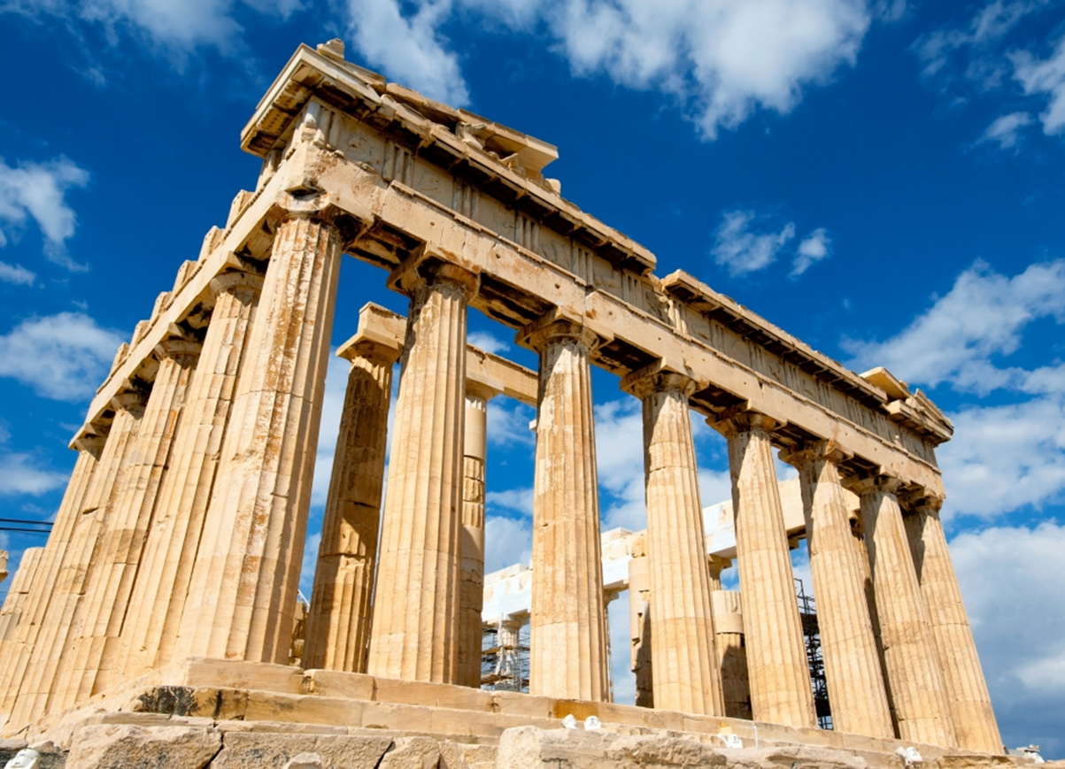

What is a democracy?
The word democracy was first used in ancient Athens - it's a combination of two Greek words: demos, a citizen of a city-state or ‘the people’, and kratos, meaning 'power' or 'rule’.
So literally, it means rule by the people.
Democracy is like a big group project where the citizens of a country get a say in how things are done.
In Australia, this means:
The right to vote: Voting is a way of expressing an opinion and for a group to come to a decision. When you turn 18, you get to vote in elections and have your say about who is in government.
Fairness: Everyone's vote counts equally. It doesn't matter if you're rich or poor, young or old—everyone’s vote has the same power.
Freedom: You can talk about what you think is right or wrong and even protest if you want changes.
Laws: Rules that help protect people and keep things fair and just.
So, democracy in Australia is about everyone having a voice and working together to make the country a better place.

Slide 3
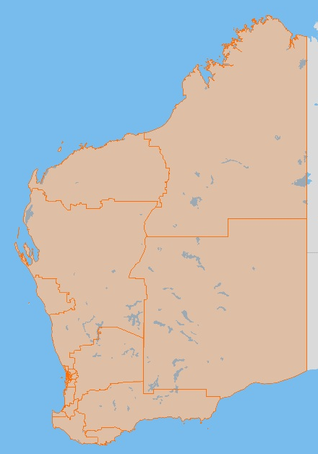

Things to know
In Australia, we choose leaders to make laws and decisions for everyone. This is called a representative democracy.
An election is the time when Australians vote to choose (or elect) the people who will make the laws and decisions that affect us all. Voting in Australia is compulsory.
Voters choose who they would like to see making laws and decisions from a list of people. These people are called candidates.
Some candidates are part of a group with shared ideas. These groups are political parties.
Candidates who are not in political parties are called independents.
Candidates put themselves forward to represent an area called an electorate.
A state-based electorate is referred to as a district.

Slide 4
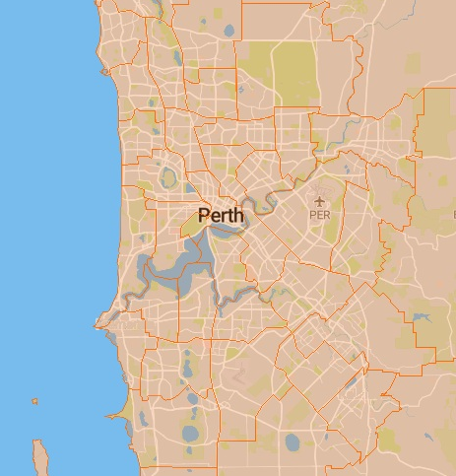
Electorates
Also known as seats, electorates are geographical areas represented by a Member of Parliament (MP).
Each electorate is designed to contain roughly the same number of voters, which means their physical size can vary greatly.
The more people living in one region, the smaller the land size of the electorate.
Western Australia is divided into 59 Legislative Assembly districts, with one whole of State electorate for the Legislative Council.

Slide 5
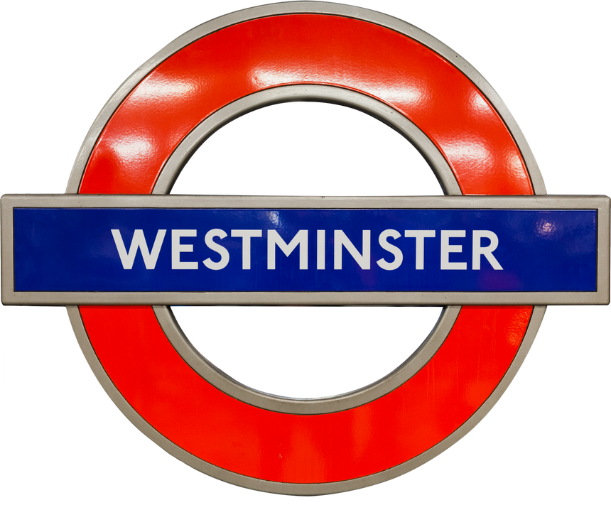



Parliament
Before 1901, Australia was made up of SIX British colonies. These colonies decided to join together or ‘federate’ to form one country.
The Commonwealth of Australia, officially becoming a nation on January 1, 1901.
Australia adopted the British model for government called the Westminster system, which operates as a group of elected representatives called Parliament.
In the Lower House, the members of parliament make and pass the laws, working with the Upper House.
Parliament has two parts: the Upper House and the Lower House. Two different groups sit in these “houses”. The people elected to these houses are called Members of Parliament (or MPs).
The political party with the most members in the Lower House after an election becomes the government.
In the Upper house, the members of parliament review the laws made by the Lower House and can ask for changes if they think it’s needed.
When Australians vote, they choose the people they want to sit in parliament to make the laws for the benefit of all Australians.

Slide 6
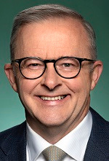


Three levels of government
in Australia’s democracy
The Federal Government makes laws for and is responsible to the whole country.
Led by the Prime Minister.
The State Government makes laws for and is responsible to a specific state or territory.
Led by State Premiers.
The Local Government manages services for and is responsible to local communities.
Each local area has a council, led by a Mayor or Shire President.
Notes:
Check image part for local

Slide 7
Three levels of government: Responsibilities
Federal Government
State
Government
Local Government
Defence
Immigration
Taxation
Currency
Overseas trade
Foreign Affairs
Post
Schools
Hospitals
Public transport
Police & Emergency Prisons
Roads & railways
Rubbish & recycling
Parks & libraries
Sporting facilities & swimming pools
Local roads & footpaths
Pet registration & control
Town planning & building approvals

Slide 8



Who is eligible to vote?
Which means...
who can vote in elections?
You need to be:
18 years or older
an Australian citizen
and on the electoral roll

Slide 9
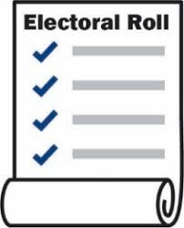


What is the electoral roll?
The electoral roll is a giant list of all the people who are enrolled to vote in elections.
People enrol to vote by completing a form. After that, their name is added to the electoral roll for the electorate where they live.
Enrolling allows you to vote in all three levels of government.
If you change your address or your name, let the Electoral Commission know so you will be listed correctly.
In Australia, just like with voting, it is compulsory for all eligible people to be enrolled to vote. That means people HAVE TO do it!

Slide 10


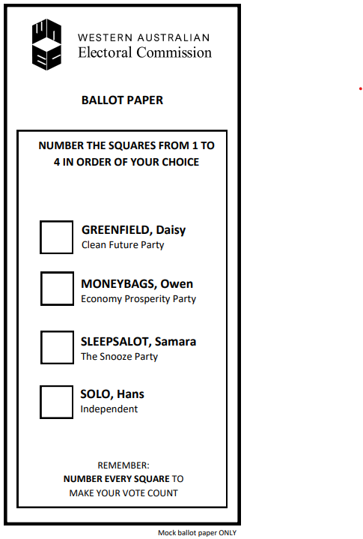
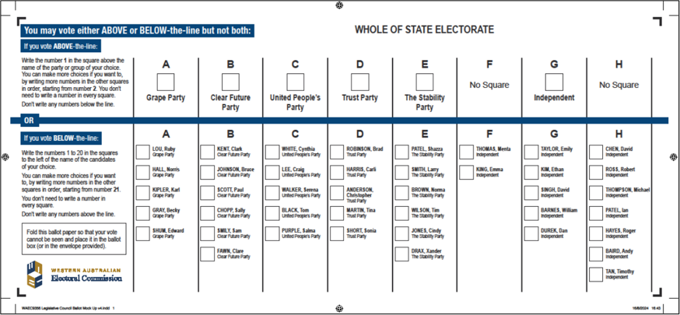
Ballot papers
A ballot paper is an official form used to vote in an election. It lists all the candidates and parties who are trying to win a seat in either the Upper House or the Lower House.
At a WA State Election, there are TWO ballot papers.
The Legislative Council ballot paper lists the candidates and parties who want to win seats in the Upper House.
The Legislative Assembly ballot paper lists the candidates who want to become members of the Lower House.

Slide 11





Preferential voting
In Australian elections, we use a preferential voting system.
Voters rank candidates in their order of preference.
This means selecting the candidates in the order that the voter likes them.
To complete the ballot paper, the voter writes numbers in ALL the boxes. This is called FULL preferential voting.
Voters write a "1" for their favorite, "2" for their second favorite, and so on until ALL the boxes have been filled in.
If you don’t fill in your ballot paper correctly, your vote will not be counted. This is called an Informal vote. Do not put your name on the ballot paper.

Slide 12
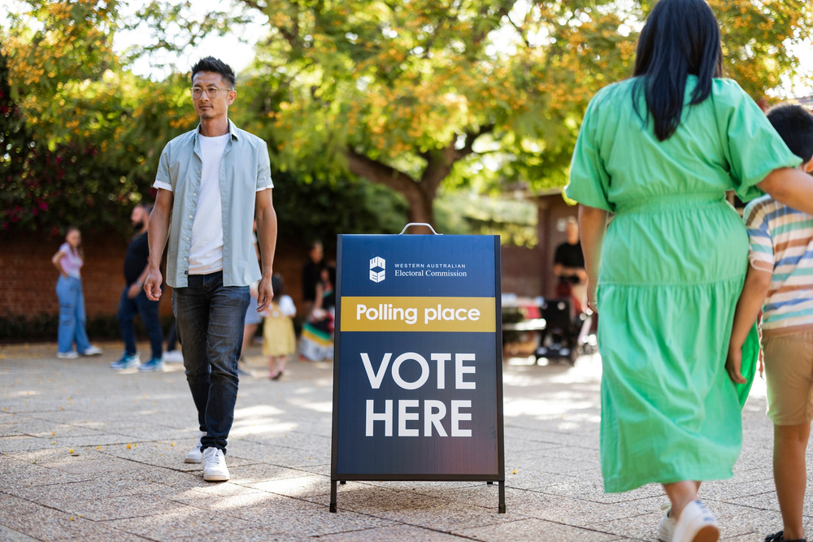

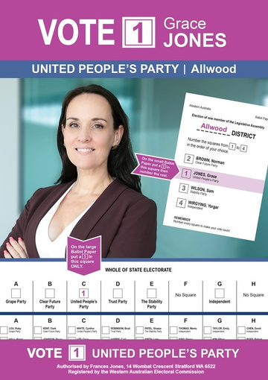

Election Day
On Election Day, voters go to a Polling Place to ‘cast’ their vote.
Polling Places are often set up in schools.
Outside a Polling Place, people who represent different Parties and Candidates hand out flyers to voters.
The flyers are called
How-to-Vote Cards.
Election Day is always on a Saturday.
Polling places open at 8am and close at 6pm.

Slide 13
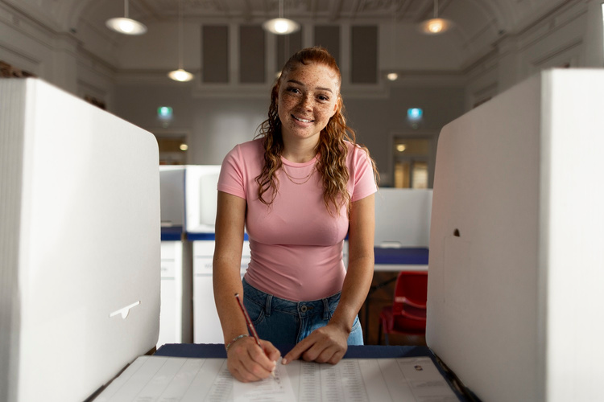
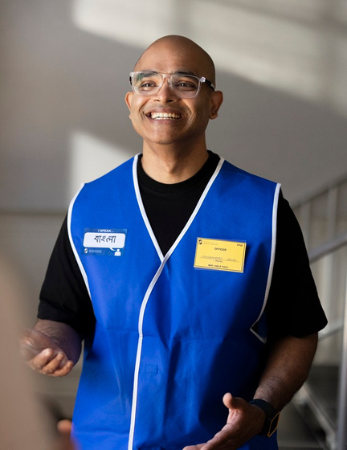
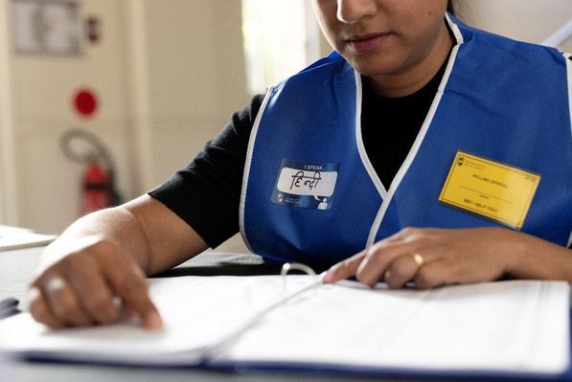
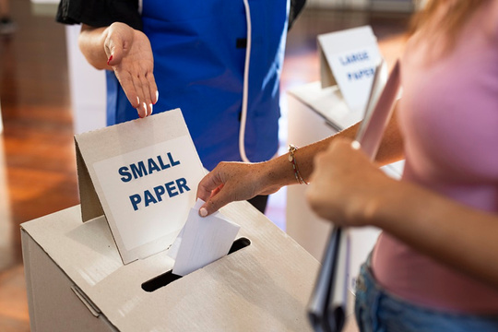

Voting at a Polling Place
Inside the Polling Place, there are Electoral workers.
They are there to help voters.
Voters are given ballot papers.
Then they complete their vote in voting screens...
They find the voters’ names on the electoral roll and mark them off.
... then they place their votes into the ballot box.

Slide 14
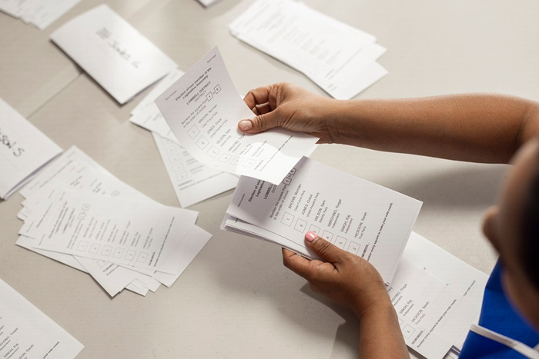

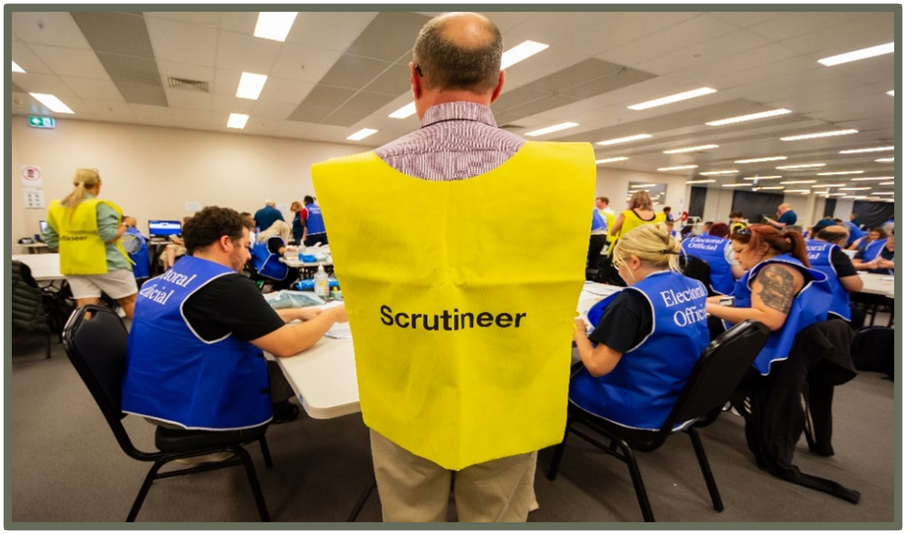

Counting the votes
After polling closes, the ballot boxes are opened at the polling places.
Election workers check the ballot papers have been correctly filled out…
and start to count the votes.
After that, all the votes from around the state are loaded onto trucks and taken to a big warehouse where the counting continues.
All the "1" votes are counted first, for each candidate.
If none of the candidates get more than half, the candidate with the fewest "1" votes is eliminated.
Their votes are then redistributed to the number “2” choices.
The process continues until one candidate has the absolute majority.
This means that candidate has more than half the votes.
That candidate is the winner.
Scrutineers are people chosen by candidates to watch the votes being counted to make sure it is done correctly.

Slide 15



Other ways of voting
In person at an Early Polling Place
Early polling places are open 11 days prior to the election day.
By post
Voters can apply to the WA Electoral Commission for state elections and receive ballot papers and instructions in the post.
Special voting categories
Silent elector
Electors who consider having their address on the publicly available Electoral Roll a risk to their safety or their family's safety can apply to be a silent elector.
Examples: Lawyers, Parole Officers, persons experiencing domestic violence.
Overseas elector
A voter with a fixed address overseas can arrange for voting papers to be posted to them. If a voter has overseas travel planned while an election is on, they need to complete an overseas notification form.
Prisoners
Prisoners serving a sentence of less than one year can vote in WA State elections.
General postal voter
For eligible voters, ballot papers are automatically posted out for an election without the need to apply for a postal vote at each election.
Phone Assisted Voting
If a voter is physically unable to complete a ballot paper, they can register for Phone Assisted Voting.
No fixed address
Includes people who are homeless, living in crisis accommodation or travelling constantly.
All votes make their way to the Central Processing Centre to be included in the count

Slide 16
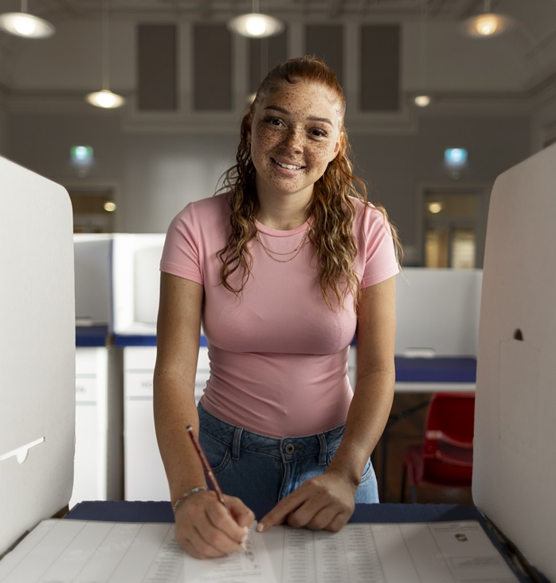
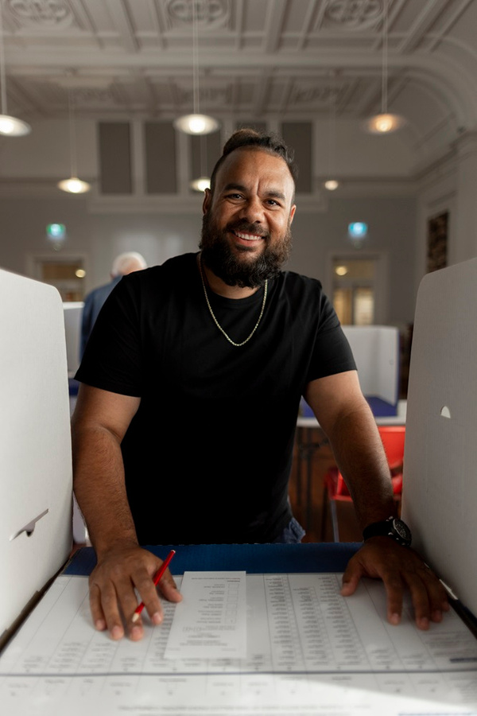



Let’s vote!

Slide 17





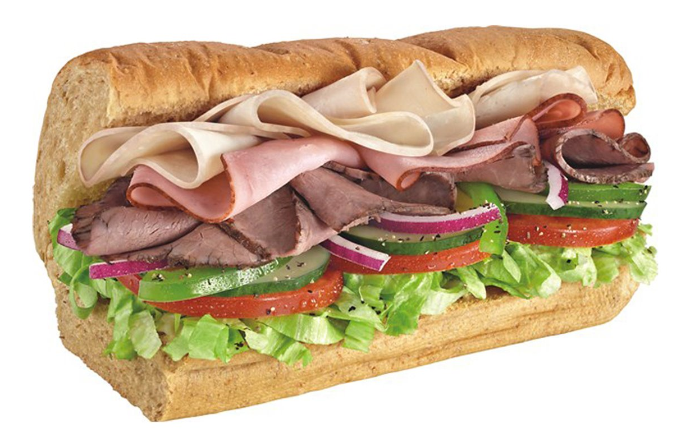
The candidates
Pizza
KFC
McDonalds
Subway

Slide 18
The preferential count
Number of valid votes
Absolute majority = 50% + 1
Absolute majority in this class is...

Slide 19

Level 2, 66 St Georges Terrace, PERTH WA 6000
GPO Box F316, PERTH WA 6841
elections.wa.gov.au

